Slide 1
Types of External Memory
Magnetic Disk
RAID
Removable
Optical
CD-ROM
CD-Writable (WORM)
CD-R/W
DVD
Magnetic Tape

Slide 2
Cakera Magnetik
Cakera logam atau plastik disaluti dgn bahan boleh-magnet (spt iron oxide…rust)
Julat pakej
Floppy
8”, 5.25”, 3.5”
Low capacity
Up to 1.44Mbyte (2.88M never popular)
Winchester hard disk
In 1973, IBM introduced the 3340 "Winchester" disk system the first to use a sealed head/disk assembly (HDA).
Almost all modern disk drives now use this technology, and the term "Winchester" became a common description for all hard disks, though generally falling out of use during the 1990s.
Removable hard disk
A type of disk drive system in which hard disks are enclosed in plastic or metal cartridges so that they can be removed like floppy disks. E.g:
Jaz - Jaz is a removable disk technology, introduced by Iomega, capable of storing approximately one gigabyte of information on a single disk.
Zip (disk) - Zip is a removable disk technology that was introduced by Iomega to allow users to store 100 megabytes of data on a disk that's only a little bigger than a three-and-a-half-inch floppy.

Slide 3
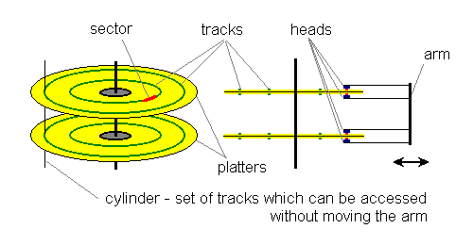
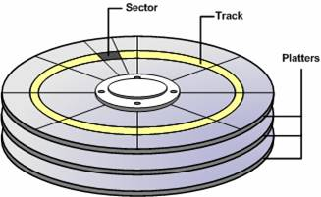
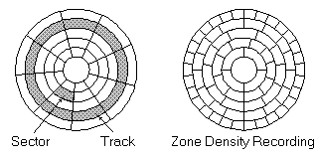
Data & Format Organization
First disks had a simple design.
They had one or more rotating platters and a moving arm with read/write heads attached to it - one head on each side of the platter.
The arm could move and stop at the certain number of positions.
When it stopped each head could read or write data on the underlying track.
Every read or write had to be done in blocks of bytes, called sectors.
Sectors were usually 512 bytes long and there were fixed number of sectors on each track.

Slide 4
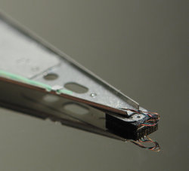
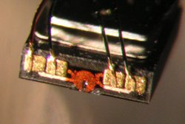
Fixed/Movable Head
Fixed head
One read write head per track
Heads mounted on fixed ridged arm
Movable head
One read write head per side
Mounted on a movable arm
Close-up of a hard disk head resting on the disk platter.
Microphotograph of a hard disk head. The size of the front edge is about 0.3 * 1.2 mm. The functional part of the head is the round, orange structure in the middle. Also note the connection wires bonded to gold-plated pads.

Slide 5
Removable or Not
Removable disk
Can be removed from drive and replaced with another disk
Provides unlimited storage capacity
Easy data transfer between systems
Nonremovable disk
Permanently mounted in the drive

Slide 6
Finding Sectors
Mesti boleh mengenalpasti runut (track) dan sektor awalan.
Format disk
Maklumat tambahan yg bukannya untuk pengguna.
Tanda runut2 dan sektor2.

Slide 7
RAID
Redundant array of independent disks, also known as redundant array of inexpensive disks (commonly abbreviated RAID) is a system which uses multiple hard drives to share or replicate data among the drives.
Depending on the version chosen, the benefit of RAID is one or more of increased data integrity, fault-tolerance, throughput or capacity compared to single drives.
RAID combines multiple hard drives into a single logical unit. Thus, instead of seeing several different hard drives, the operating system sees only one.

Slide 8
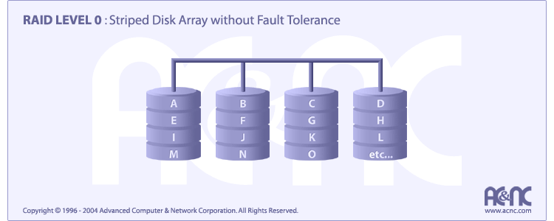
RAID 0
A RAID 0 (also known as a striped set) splits data evenly across two or more disks with no parity information for redundancy.
It is important to note that RAID 0 was not one of the original RAID levels, and is not redundant.
RAID 0 is normally used to increase performance, although it can also be used as a way to create a small number of large virtual disks out of a large number of small physical ones.

Slide 9
RAID 0
No redundancy
Data striped across all disks
Round Robin striping
Increase speed
Multiple data requests probably not on same disk
Disks seek in parallel
A set of data is likely to be striped across multiple disks

Slide 10
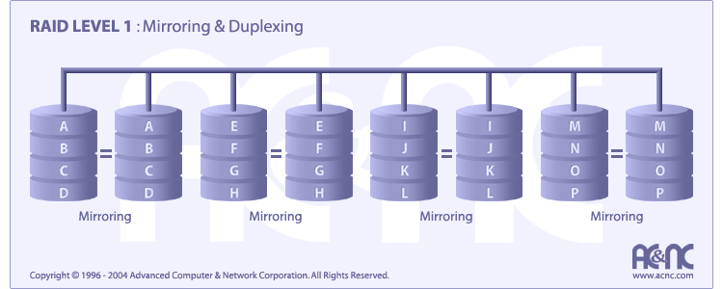
RAID 1
A RAID 1 creates an exact copy (or mirror) of a set of data on two or more disks.
This is useful when read performance is more important than minimizing the storage capacity used for redundancy.
The array can only be as big as the smallest member disk, however.
A classic RAID 1 mirrored pair contains two disks, which increases reliability by a factor of two over a single disk, but it is possible to have many more than two copies.
Since each member can be addressed independently if the other fails, reliability is a linear multiple of the number of members.
To truly get the full redundancy benefits of RAID 1, independent disk controllers are recommended, one for each disk.
Some refer to this practice as splitting or duplexing.

Slide 11
RAID 1
Mirrored Disks
Data is striped across disks
2 copies of each stripe on separate disks
Read from either
Write to both
Recovery is simple
Swap faulty disk & re-mirror
No down time
Expensive

Slide 12
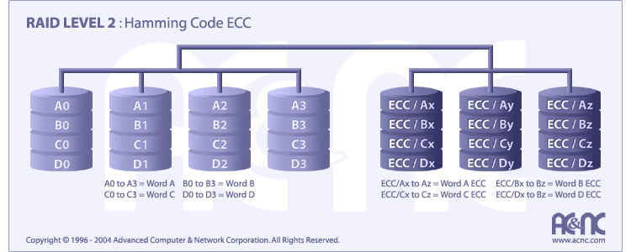
RAID 2
A RAID 2 stripes data at the bit (rather than block) level, and uses a Hamming code for error correction.
The disks are synchronized by the controller to run in perfect tandem.

Slide 13
RAID 2
Disks are synchronized
Very small stripes
Often single byte/word
Error correction calculated across corresponding bits on disks
Multiple parity disks store Hamming code error correction in corresponding positions
Lots of redundancy
Expensive
Not used

Slide 14
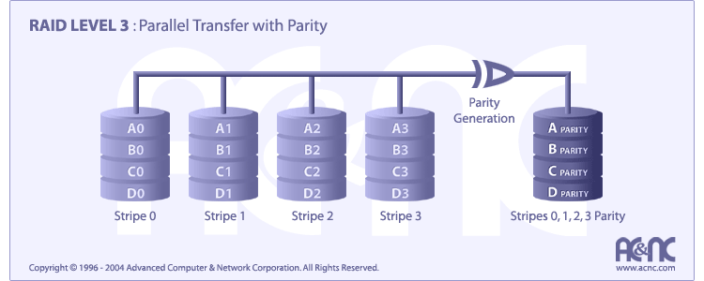
RAID 3
A RAID 3 uses byte-level striping with a dedicated parity disk.
RAID 3 is very rare in practice.
One of the side effects of RAID 3 is that it generally cannot service multiple requests simultaneously.
This comes about because any single block of data will by definition be spread across all members of the set and will reside in the same location, so any I/O operation requires activity on every disk.

Slide 15
RAID 3
Similar to RAID 2
Only one redundant disk, no matter how large the array
Simple parity bit for each set of corresponding bits
Data on failed drive can be reconstructed from surviving data and parity info
Very high transfer rates

Slide 16

RAID 4
A RAID 4 uses block-level striping with a dedicated parity disk.
RAID 4 looks similar to RAID 3 except that it stripes at the block, rather than the byte level.
This allows each member of the set to act independently when only a single block is requested.
If the disk controller allows it, a RAID 4 set can service multiple read requests simultaneously.

Slide 17
RAID 4
Each disk operates independently
Good for high I/O request rate
Large stripes
Bit by bit parity calculated across stripes on each disk
Parity stored on parity disk

Slide 18
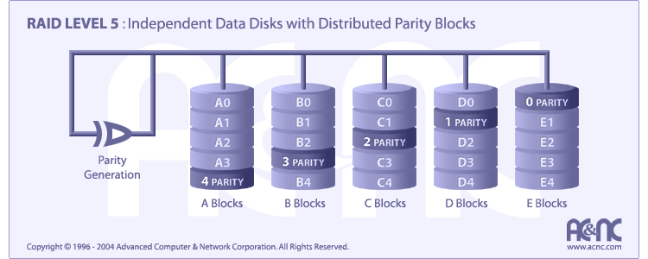
RAID 5
A RAID 5 uses block-level striping with parity data distributed across all member disks.
RAID 5 has achieved popularity due to its low cost of redundancy.
Generally RAID 5 is implemented with hardware support for parity calculations.

Slide 19
RAID 5
Like RAID 4
Parity striped across all disks
Round robin allocation for parity stripe
Avoids RAID 4 bottleneck at parity disk
Commonly used in network servers

Slide 20
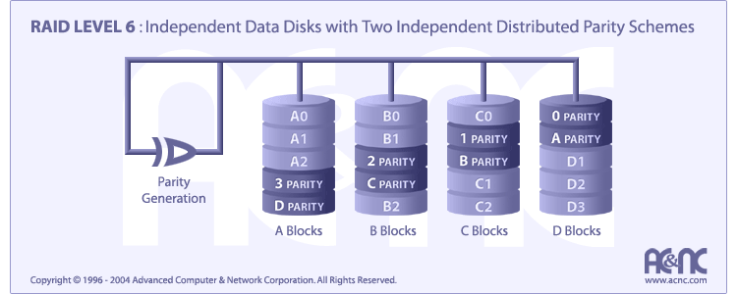
RAID 6
A RAID 6 extends RAID 5 by adding an additional parity block, thus it uses block-level striping with two parity blocks distributed across all member disks.

Slide 21
Optical Storage CD-ROM
Originally for audio
650Mbytes giving over 70 minutes audio
Polycarbonate coated with highly reflective coat, usually aluminium
Data stored as pits
Read by reflecting laser
Constant packing density
Constant linear velocity

Slide 22
CD-ROM Drive Speeds
Audio is single speed
Constant linier velocity
1.2 ms⁻¹
Track (spiral) is 5.27km long
Gives 4391 seconds = 73.2 minutes
Other speeds are quoted as multiples
e.g. 24x
Quoted figure is maximum drive can achieve

Slide 23
CD-ROM Format
00
FF
x 10
00
Layered
ECC
Sec
Mode
Data
Min
Sector
12 byte
Sync
4 byte
Id
2048 byte
288 byte
2352 byte
Mode 0=blank data field
Mode 1=2048 byte data+error correction
Mode 2=2336 byte data

Slide 24
Random Access on CD-ROM
Difficult
Move head to rough position
Set correct speed
Read address
Adjust to required location

Slide 25
CD-ROM for & Against
Large capacity (?)
Easy to mass produce
Removable
Robust
Expensive for small runs
Slow
Read only

Slide 26
Other Optical Storage
CD-Writable
WORM (Write Once Read Many)
Now affordable (mampu dibeli)
Compatible with CD-ROM drives
CD-RW
Boleh-padam (Erasable)
Getting cheaper
Mostly CD-ROM drive compatible
Phase change
Material has two different reflectivities in different phase states

Slide 27
DVD - What’s in a Name?
DVD (sometimes known as "Digital Versatile Disc" or "Digital Video Disc") is an optical disc storage media format that can be used for data storage, including movies with high video and sound quality.

Slide 28
DVD - Technology
Multi-layer
Very high capacity (4.7G per layer)
Full length movie on single disk
Using MPEG compression
Finally standardized (honest!)
Movies carry regional coding
Players only play correct region films
Can be “fixed”

Slide 29
DVD - Writable
Loads of trouble with standards (Masalah Piawai)
First generation DVD drives may not read first generation DVD-W disks
First generation DVD drives may not read CD-RW disks
Wait for it to settle down before buying!

Slide 30
Foreground Reading
Check out optical disk storage options
Check out mini disk

Slide 31
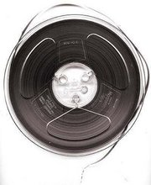
Magnetic Tape
Serial access
Slow
Very cheap
Backup and archive

Slide 32
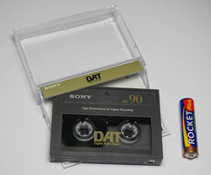
Digital Audio Tape (DAT)
Is a signal recording and playback medium.
Uses rotating head (like video)
High capacity on small tape
4Gbyte uncompressed
8Gbyte compressed
Backup of PC/network servers
A 90-minute DAT cartridge, size compared to an AAA(LR03) battery.

Slide 33
What is virtual memory?
Virtual memory is a method of making a computer seem to have more Random Access Memory (RAM) than it actually does. By reallocating available disk space, the operating system of the computer transparently swaps chunks of memory to and from the hard disk.
The advantage of doing this is that larger application programs can be loaded, more applications can be used simultaneously, and the programs have more space to store their data.
A drawback of virtual memory is that it slows down system operation and is limited to the amount of disk space that is free on the system.

Slide 34
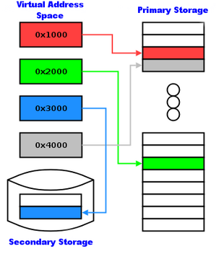
Virtual Memory
Virtual memory addressing is a memory management technique, used by multitasking computer operating systems wherein non-contiguous memory is presented to a software application as contiguous memory.
The contiguous memory is referred to as the virtual address space.
Why virtual memory?
Shortage of memory
Efficient memory management needed
Process may be too big for physical memory
More active processes than physical memory can hold
Requirements of multiprogramming
Efficient protection scheme
Simple way of sharing

Slide 35
Virtual Memory
Virtual memory allows software to run in a memory address space whose size and addressing are not necessarily tied to the computer's physical memory.
To properly implement virtual memory the CPU (or a device attached to it) must provide a way for the operating system to map virtual memory to physical memory and for it to detect when an address is required that does not currently relate to main memory so that the needed data can be swapped in.
size of information blocks that are transferred from secondary to main storage (M) → Swapping policy
block of information brought into M, and M is full, then some region of M must be released to make room for the new block --> replacement policy
which region of M is to hold the new block --> placement policy
missing item fetched from secondary memory only on the occurrence of a fault --> demand load policy

Slide 36
Virtual Memory
In paging, the low order bits of the binary representation of the virtual address are preserved, and used directly as the low order bits of the actual physical address; the high order bits are treated as a key to one or more address translation tables, which provide the high order bits of the actual physical address.
For this reason a range of consecutive addresses in the virtual address space whose size is a power of two will be translated in a corresponding range of consecutive physical addresses. The memory referenced by such a range is called a page.
mem
disk
cache
reg
pages
frame
Paging Organization
virtual and physical address space partitioned into blocks of equal size
page frames
pages

